Slide 1


On the Road to Dissemination
Notes:
On behalf of the North Carolina Organization of Nurse Leaders and the Research Committee, thank you for attending today’s abstract writing workshop.

Slide 2

On The Road to Dissemination, travelers will learn how to:
Respond to a call for abstracts
Craft a clear and compelling abstract
Submit an abstract in Qualtrics
Request additional coaching
Notes:
I would be remiss if I did not include learning objectives.
Upon arrival to destination dissemination, travelers will be able to
1. Respond to a call for abstracts
2. Craft a clear, compelling abstract that gets your work seen and sets your ideas on the road to a wider audience.
3. Submit an abstract in Qualtrics
4. Request additional coaching if you want

Slide 3
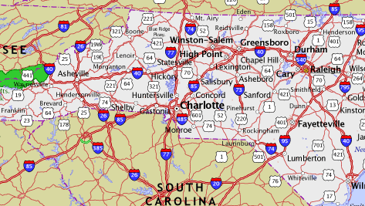
What is an Abstract?
Notes:
If you were going to take a trip anywhere across our great state, you would use some sort of navigation tool such as a map or an app on your phone.
An abstract works similarly. It maps out what you will cover, why it matters and the arrival destination without detours.
So, you get an email with a call for abstracts. How do you respond?
First consider the organization holding the conference.
What does the professional organization value?
Does the work you are doing align with their strategic goals?

Slide 4

Notes:
Just as an inset on a map gives you a glimpse of the larger map, your abstract serves the same purpose.
It should be Informative, and accurate
Use active voice in present tense. For example, we present our findings….
Reviewers travel fast. Clear, active language keeps them on the path and signals a talk that respects their time.
Lead with strong verbs-“We cut,” “we built,” “we proved” beat “we explored” or “we looked at.” Use active voice
Cut the jargon-Write so a smart outsider gets it. Acronyms cost you readers.
Concrete data- real numbers, Numbers, names, and specifics land harder than adjectives.
Brief statements-One idea per sentence. Momentum keeps reviewers reading.
Know your audience
Before you begin writing, typing, read the guidelines!

Slide 5

Notes:
Your abstract provides direction, but it is important to follow directions.
Writing our abstracts for submission to a conference and presenting a poster or presentation is an exciting final step for the work you have done.
Conferences are great avenues for to disseminate, share new ideas that work, obtain feedback.
You also nudge others to think differently, differently about how they do things and about the work you have done

Slide 6
Abstract Guidelines
Provide Abstract Title and Author Name(s) with Credentials and Organizational Affiliation(s)
Note character limit per header. This includes counting spaces between characters.
Indicate your permission to include your abstract on the NCONL website
Indicate the abstract category: Quality Improvement/Evidence-Based Practice Projects (QI/EBP) OR Research Study
Submit your content into the required subject headers. You may type this into the section box or copy & paste from a document.
Provide 3-5 references (no character or word limit) in the reference section.
Reviewer criteria rubric is available online.
ON THE ROAD TO DISSEMINATION
Notes:
A call for abstracts will include instructions.
Read them! Follow them!
This includes standards, word limit, formatting and reviewer criteria.
These are the NCONL Abstract Guidelines.

Slide 7
Abstract Guidelines
Required Subheadings Vary by Project Type
Header Character Count Maximum | QI/EBP Project
375 Characters | Local Problem/Project Trigger(s)
250 Characters | Project Goals/Aim/Problem Statement
500 Characters | EBP or QI Design
500 Characters | Results/Findings
375 Characters | Conclusions/Implications and Recommendations for Practice

Slide 8
Abstract Guidelines
Required Subheadings Vary by Project Type
Header Character Count Maximum | Research Study
375 Characters | Background/Significance/Introduction
250 Characters | Aims/Hypothesis/Purpose/Objective
500 Characters | Methods and Evaluation
500 Characters | Results
375 Characters | Conclusions and Implications for Practice

Slide 9

Chart Your Route
Before You Write
Check the Map
Choose the Destination
Cultivate the Plan
Notes:
Chart your route before you write. Plan ahead, set goals when you start your project. Abstracts should never be an afterthought.
Check the map. Note the theme, tracks, word limit, and exactly what reviewers score in the call for proposals
Choose the destination. Match the level and interests of the people you want to reach.
Cultivate the plan. Mark the deadline and leave room to draft, rest, and revise — never submit a first draft.
Set the goals when you start your project, not at the end.
Identify your measures for success. After you've identified your measures to attain outcomes, then what are your steps to get there?
To avoid wondering if you measured anything at all, cultivate a plan. Once you are successful in this endeavor you will want to share your work so prepare for writing an abstract.
Don't think of an abstract after the project is done. If you have planned ahead you will know what approach was utilized
You do not want to be writing an abstract and trying to mold your work into a category where it does not fit or belong.
Great content wins the slot, but the details keep you on the road. Match the rules exactly.
Land inside the limit.
Typos read as carelessness. Get a second set of eyes.
Revise, rest, and revise again
Wrong length, wrong track, missing required fields.

Slide 10

Chart Your Route
1
2
3
4
5
Hook
Problem
Approach
Results
Takeaway
ON THE ROAD TO DISSEMINATION
Notes:
Five stops, in order. Guide the reader through each one and your abstract charts its own course.
Hook-Mark the starting point — the tension or opportunity that makes people set out.
Problem-Name the specific challenge and why it matters now.
Approach-Show the road you took or will share to address it.
Results-Point to the destination — the outcome, evidence, or insight you'll reveal.
Takeaway-Promise where the audience arrives, able to do more.
Share your success so that someone else can implement it to be successful themselves. Pay attention to the detail of how you develop your process or your project so people would always have that moment of enlightenment. You know those moments when you think to yourself, I should have come up with that!

Slide 11
Chart Your Route
1
Hook
ON THE ROAD TO DISSEMINATION
Notes:
When someone reads your abstract, you want them to say yes we need this in our conference!
This occurs with a well written introduction that draws in the reader.
You hook them by clearly identifying your project. This will set the direction and tone.
For QI/EBP this is your Local Problem or Project Trigger.
For Research this is the background, significance, and introduction

Slide 12
Chart Your Route
2
Problem
ON THE ROAD TO DISSEMINATION
Notes:
State the specific challenge you tackled and why it matters right now.
What is the problem? Concise description of the problem statement including rationale for project, significance and relevance.
Include goals, benchmarks, gaps, or variations at baseline.
With QI, what is currently known about the problem? Project Goals/Aim/Problem Statement
For researchAims/Hypothesis/Purpose/Objective

Slide 13
Chart Your Route
3
Approach
ON THE ROAD TO DISSEMINATION
Notes:
Chart the route and destination
Describe what you did
For QI/EBP this includes your design and framework. PDSA, A3, IOWA Model
in research Methods and Evaluation

Slide 14
Chart Your Route
4
Results
ON THE ROAD TO DISSEMINATION
Notes:
Point to concrete outcomes or evidence.
Demonstrate measurable outcomes.
Numbers speak louder than anything. If people say, it was a success, it was great, yay! Okay, then what?
You really want to know or reflect, you really want your audience or your reader to know what success looks like. And success isn't something that you just say.
It was fantastic. No, you need to be able to speak about the success in concrete terms. Let your reader decide on that success.
write it. succinctly, you could say 93% nurses report feeling safer at work since the visitor screening implementation.
It's more focused, you're speaking in numbers, you're presenting real details
Pay close attention to that as you present your outcomes. What to include and leave out in writing your abstract.
Do stick to the details. Don't claim something you didn't make happen. Be truthful.
Use words that go straight to the point.. We don't need flowery words here. Organize your thoughts and ensure it reflects your writing.

Slide 15
Chart Your Route
5
Takeaway
ON THE ROAD TO DISSEMINATION
Notes:
What is the takeaway. Conclude with the promise of where your reader has arrived.
What they'll be able to do differently. This is the line that turns a summary into a reason to make the trip.
What are the meaningful conclusions? Lessons learned? Was the process adopted in other units within the hospital or other hospitals within an organization?
Was the project unsuccessful? If so, that is okay to share. It avoids others from making the same mistakes.
Do not use extraneous words that draw out the length of the sentence.
Go straight to the point. Avoid sounding ambiguous. Clarity is critical in abstract writing. Be creative and professional.
Strike a balance in piquing interest and being trustworthy . Reflect value and information that people could use to inform their practice.
Writing in third person makes the reader feel involved in the process
Use active voice and avoid using useless fluff.
Instead of novel innovative project.. You can say the strategy, the model, the framework.

Slide 16

Landmark Titles
Clear
Powerful
Memorable
Notes:
Write the abstract before you write the title, not the other way around.
Even though the title is the hook, your inspiration for the title will come from the abstract writing. Ideally, not more than 10 to 12 words.
Again review the guideline. A lot of the conference, there are very limited title characters,
Your title is the landmark reviewers and attendees spot first. Make it specific, benefit-led, and easy to say out loud.
Read it aloud; if it stumbles, cut words
Create a catchy title, but not cheesy. The title must resonate with the abstract.
It needs to be able to echo conference goals.
There should be alignment. Conference goals and themes, title, objectives, outcomes, all of that needs to string together.
Make the reader curious too. So an interesting title would make them think, I would like to hear more about that. Make them excited.

Slide 17



Final Steps Before Departure
Does the hook draw in the reader?
1
Is the takeaway specific and realistic?
5
Are statements clear and concise?
2
Does the title attract attention and connect to the work?
3
Did I check the character count?
4

Slide 18
Submitting your abstract in QUALTRICS
Notes:
Now we look at Qualtrics and how to submit your abstract.

Slide 19
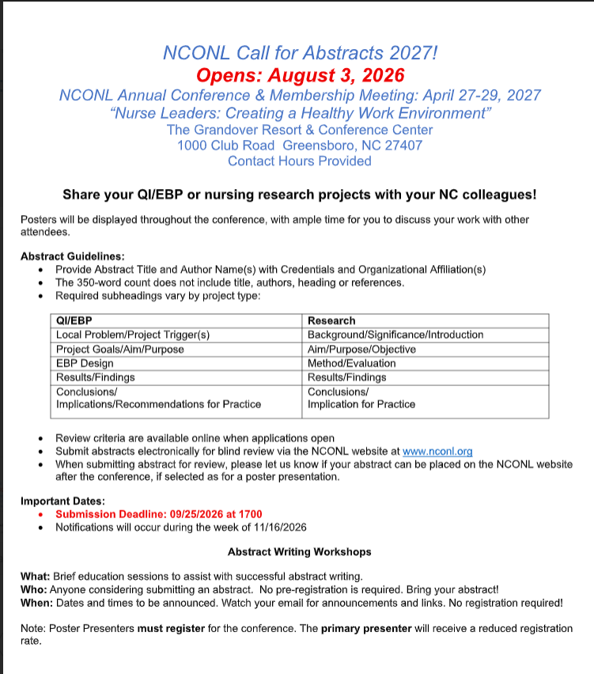
Notes:
This is the call for abstracts attached to the email you received from NCONL.
Click the link shown in the circle. It will bring you to this page to the NCONL website.

Slide 20
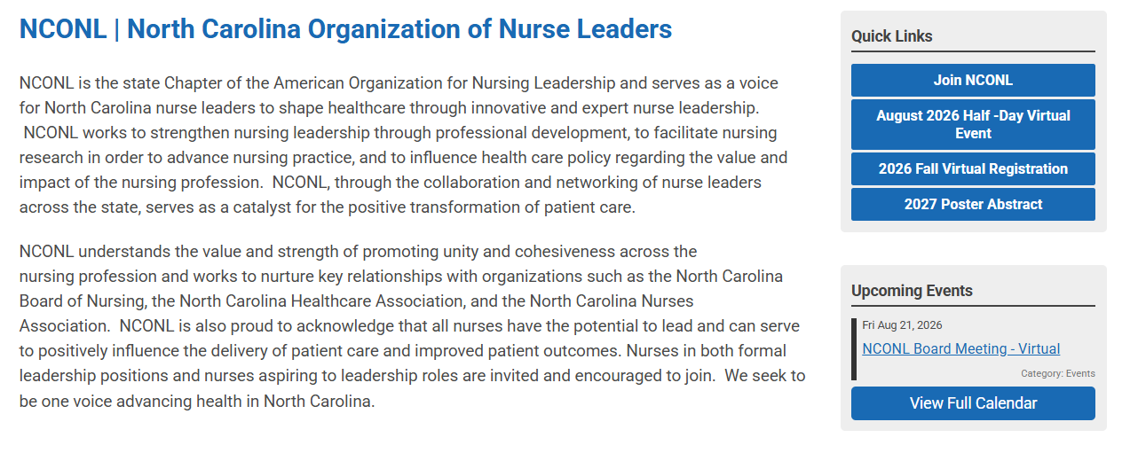
Notes:
Once on the website, click on 2027 Poster Abstract

Slide 21
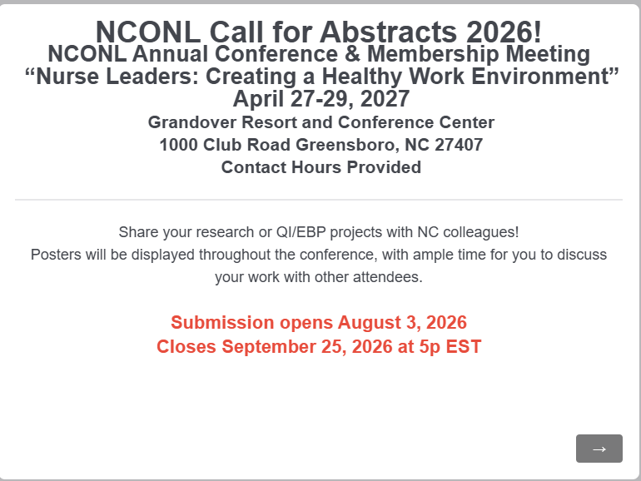
Notes:
Clicking will bring you to first page of Qualtrics which looks like this.

Slide 22
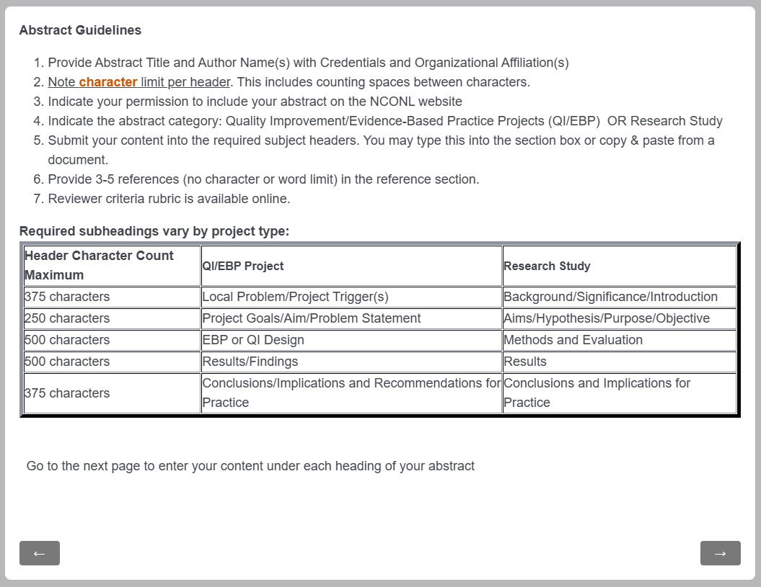
Notes:
These are the same guidelines we reviewed at the beginning of the presentation

Slide 23
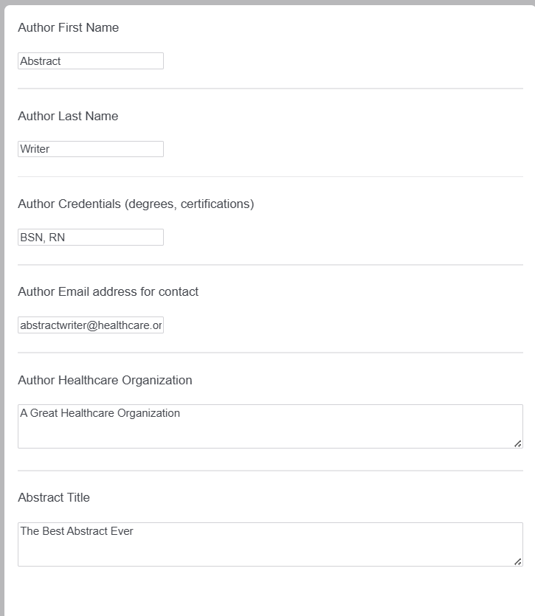
Abstract Guidelines
Provide Abstract Title and Author Name(s) with Credentials and Organizational Affiliation(s)
Notes:
A call for abstracts will include instructions.
Read them! Follow them!
This includes standards, word limit, formatting and reviewer criteria.
These are the NCONL Abstract Guidelines.

Slide 24
Abstract Guidelines
Provide Abstract Title and Author Name(s) with Credentials and Organizational Affiliation(s)
Note character limit per header. This includes counting spaces between characters.
Indicate your permission to include your abstract on the NCONL website
Indicate the abstract category: Quality Improvement/Evidence-Based Practice Projects (QI/EBP) OR Research Study
Submit your content into the required subject headers. You may type this into the section box or copy & paste from a document.
Provide 3-5 references (no character or word limit) in the reference section.
Reviewer criteria rubric is available online.
ON THE ROAD TO DISSEMINATION
Notes:
A call for abstracts will include instructions.
Read them! Follow them!
This includes standards, word limit, formatting and reviewer criteria.
These are the NCONL Abstract Guidelines.

Slide 25
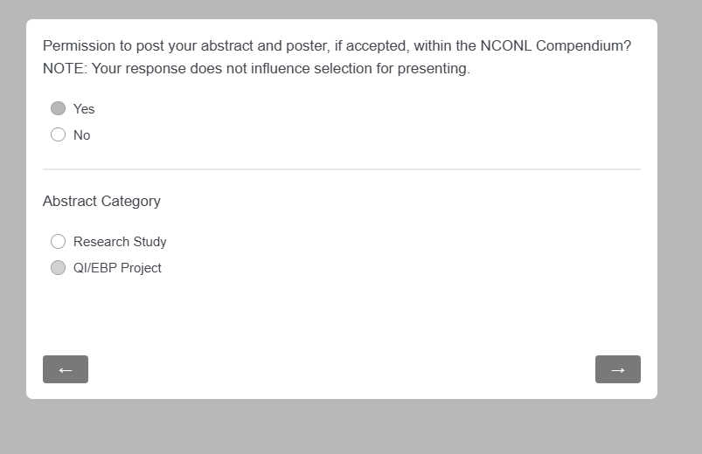

Slide 26
Abstract Guidelines
Provide Abstract Title and Author Name(s) with Credentials and Organizational Affiliation(s)
Note character limit per header. This includes counting spaces between characters.
Indicate your permission to include your abstract on the NCONL website
Indicate the abstract category: Quality Improvement/Evidence-Based Practice Projects (QI/EBP) OR Research Study
Submit your content into the required subject headers. You may type this into the section box or copy & paste from a document.
Provide 3-5 references (no character or word limit) in the reference section.
Reviewer criteria rubric is available online.
ON THE ROAD TO DISSEMINATION

Slide 27
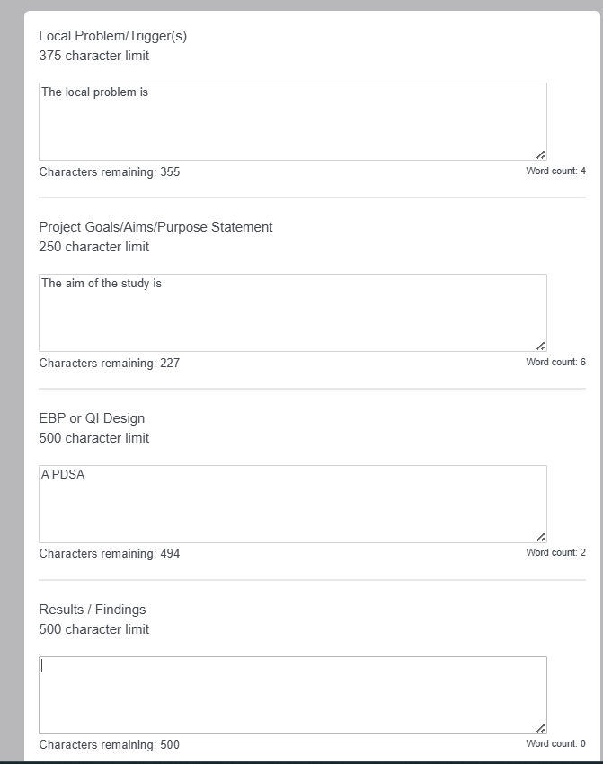
Notes:
Type your abstract in a separate document. Then copy and paste into the box under the appropriate heading. This part may require some trial and error on your part to ensure everything fits
Unsure how to check your character count?

Slide 28

Checking Character Count in Word

Slide 29
Abstract Guidelines
Provide Abstract Title and Author Name(s) with Credentials and Organizational Affiliation(s)
Note character limit per header. This includes counting spaces between characters.
Indicate your permission to include your abstract on the NCONL website
Indicate the abstract category: Quality Improvement/Evidence-Based Practice Projects (QI/EBP) OR Research Study
Submit your content into the required subject headers. You may type this into the section box or copy & paste from a document.
Provide 3-5 references (no character or word limit) in the reference section.
Reviewer criteria rubric is available online.
ON THE ROAD TO DISSEMINATION

Slide 30
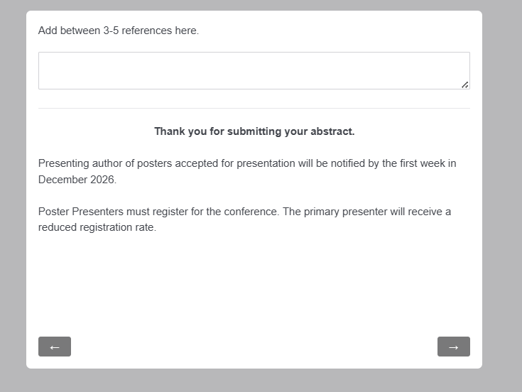

Slide 31
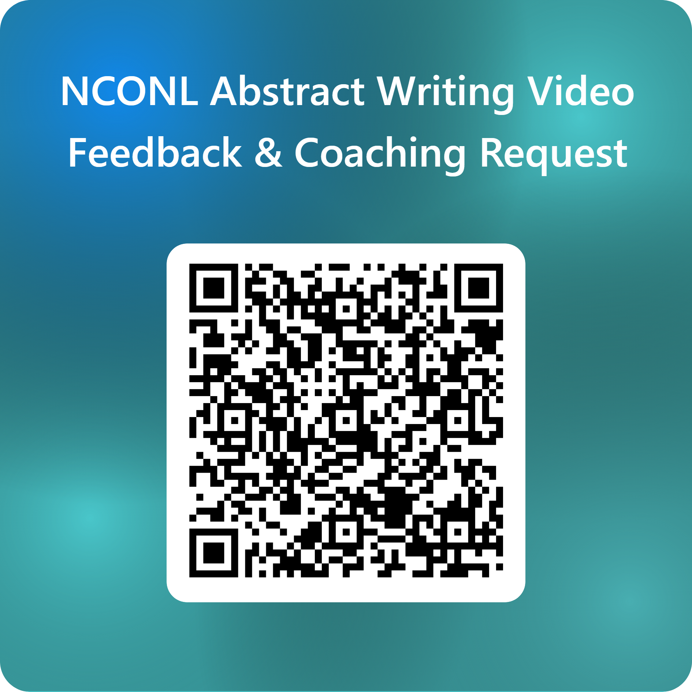
Before you leave…

